Slide 1

TCP/IP VS OSI MODEL
TEAM 1: AIDAN CURLEY, ALICE VILLAR, IAN WOLLOFF, LUKMAN MOHAMED
UNIVERSITY OF ESSEX ONLINE, UK.
MODULE 4 NETWORK AND INFORMATION SECURITY MANAGEMENT (NISM) - SEMINAR 2

Slide 2
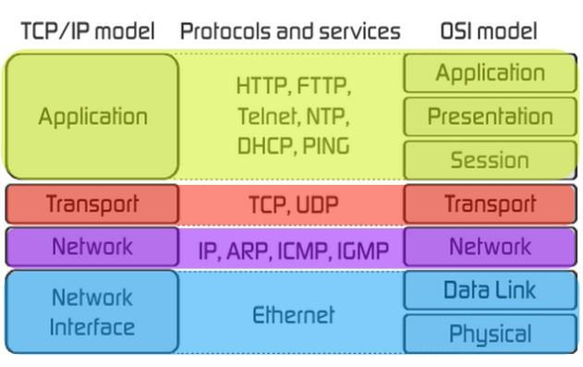
INTRODUCTION TO OSI MODEL AND TCP/IP MODEL
The two most commonly used communication network models are TCP / IP and OSI:
OSI Model (Open Systems Interconnection Model): a conceptual framework used to describe the functions of a networking system.
TCP/IP (Transmission Control Protocol/ Internet Protocol): specifically designed as a model to offer highly reliable and end-to-end byte stream over an unreliable internetwork.

Slide 3
HISTORY OF OSI MODEL
1973
1983
An Experimental Packet Switched System in the UK identified the requirement for defining the higher-level protocols.
The OSI model was initially intended to be a detailed specification of actual interfaces.
The ISO conducted a program to develop general standards and methods of networking.
The OSI architecture was formally adopted by ISO as an international standard.
late 1970s
1984

Slide 4
HISTORY OF TCP/IP MODEL
1974
1982
1990
Vint Cerf and Bob Kahn published a paper “A Protocol for Packet Network Interconnection” which describes the TCP/IP Model.
It was decided that TCP/IP should replace NCP as the standard language of the ARPAnet.
ARPAnet was decommissioned.
The Internet grew from ARPAnet’s roots.
TCP/IP evolved to meet the changing requirements of the Internet.
Testing and further development led to a new suite of protocols called TCP/IP.
In 1983, ARPAnet switched over to TCP/IP,
1978
1983

Slide 5
WOULD THE INTERNET BE BETTER IF IT WAS BASED ON THE ISO/ OSI 7-LAYER MODEL RATHER THAN TCP/IP?
Shortcomings of OSI 7-Layer Model
Less Practical
The standards of OSI model are theoretical and do not offer adequate solutions for practical network implementation.
TCP/IP model was very much preferred because it addressed the practical needs of network implementation more effectively.
Less Reliable Data Transmission
TCP stands for Transmission Control Protocol which indicates that it does something to control the transmission of the data in a reliable way.
The OSI model does not have any special mechanism for providing a reliable and secure connection for data transmission, whereas the TCP/IP model has a 3-way handshake mechanism which provides a reliable and secure connection link over the network.

Slide 6
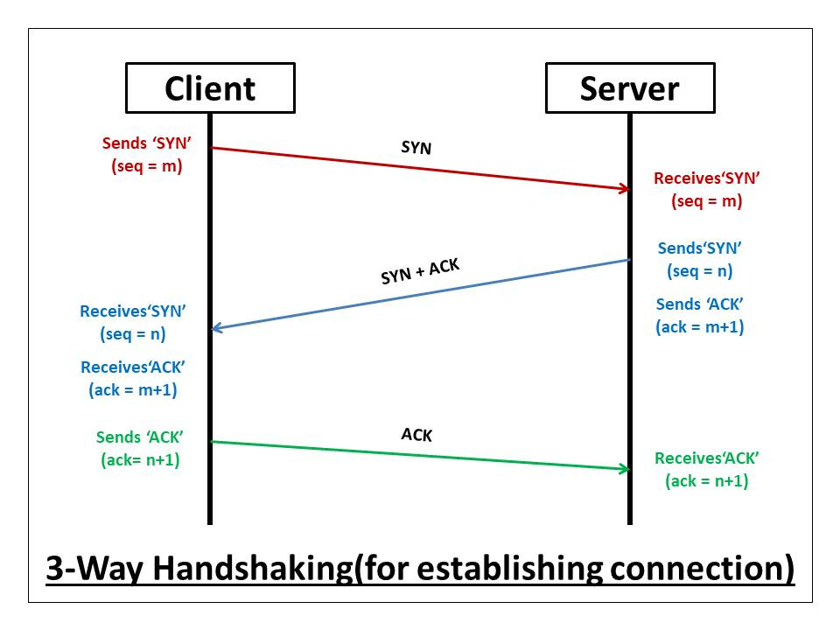
INTRODUCTION TO TCP/IP MODEL
SYN: The active open is performed by the client sending SYN to the server. The client sets the segment's sequence number to a random value A.
SYN-ACK: In response, the server replies with a SYN-ACK. The acknowledgment number is set to one more than the received sequence number i.e. A+1, and the sequence number that the serve chooses for the packet is another random number, B.
ACK: Finally, the client sends an ACK back to the server. The sequence number is set to the received acknowledgement value i.e. A+1, and the acknowledgement number is set to one more than the received sequence number i.e. B+1.

Slide 7
ADVANTAGES OF TCP/IP
It helps you to establish/set up a connection between different types of computers.
It operates independently of the operating system.
It supports many routing-protocols.
It enables internetworking between organizations.
TCP/IP model has a highly scalable client-server architecture.

Slide 8
REFERENCES
Russell, A.L. (2006) ‘Rough Consensus and Running Code’ and the Internet-OSI Standards War.
IEEE Annals of the History of Computing.
Available from: https://www2.cs.duke.edu/courses/common/compsci092/papers/govern/consensus.pdf
Williams, Lawrence. (2021) TCP/IP vs OSI Model: What’s the Difference?. Guru99
https://www.guru99.com/difference-tcp-ip-vs-osi-model.html
DDOS Guard. https://ddos-guard.net/en/terminology/protocols/tcp-3-way-handshake
After-Academy. What is a TCP 3-way handshake process?
https://afteracademy.com/blog/what-is-a-tcp-3-way-handshake-process

